Slide 1
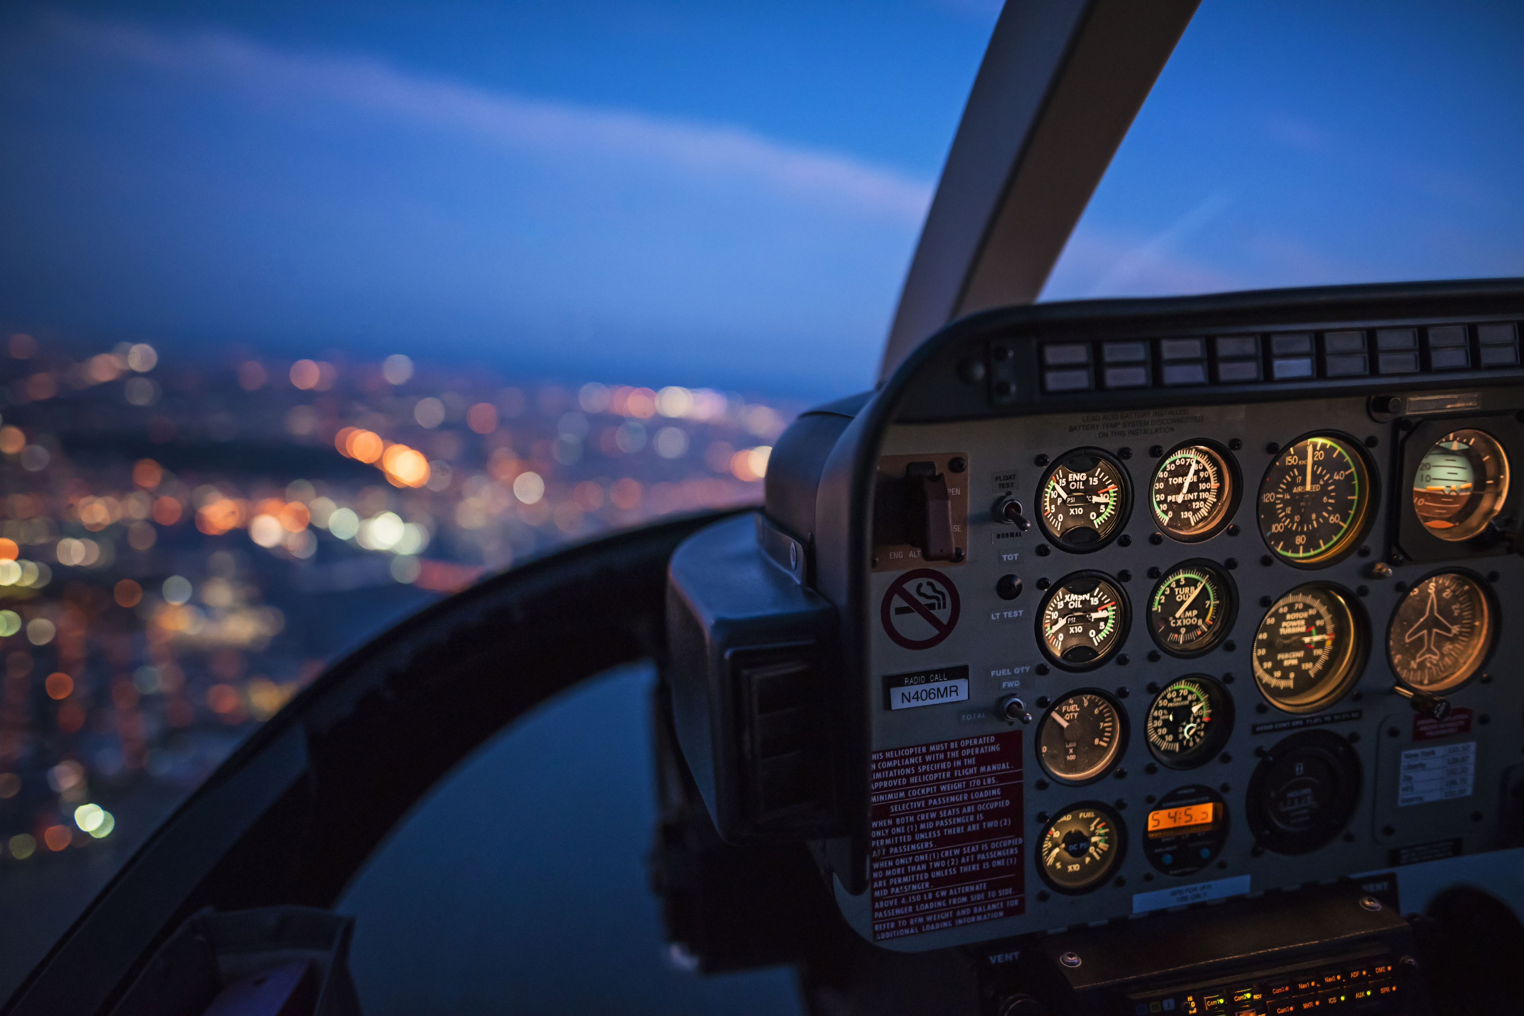
Final Project – Airlines Case Study
INSTRUCTIONS: To change image
> Click on View > Slide Master
> Click on the image again > Hit delete > Insert or drag your new image
> Right click on the new image ’Send to Back’ to reveal the text
> Crop and adjust the image appropriately
> Branding Zone Link for images
Bhargav Reddy
21 August 2023

Slide 2
Problem Statement
Dataset contains information about flight booking options from the website Easemytrip for flight travel between India's top 6 metro cities.
AIM:
To analyse the flight booking dataset obtained from “Ease My Trip” website and to conduct
various statistical hypothesis tests in order to get meaningful information from it.
Steps Involved:
Exploratory Data Analysis and Insights (What are initial conclusions from the analysis)
Data Pre-processing
Model Building and Evaluation
Model deployment Ideas and Business Use Case (How can this is deployed or sold as a product)
Method: Machine Learning

Slide 3
Data Overview
There are 300261 datapoints and 11 features in the cleaned dataset.
Numeric Columns:
'duration', 'days_left', 'price’
Categorical Columns:
'destination_city’, 'departure_time’, 'class’, 'airline’, 'stops’, 'source_city’, 'flight', 'arrival_time'

Slide 4
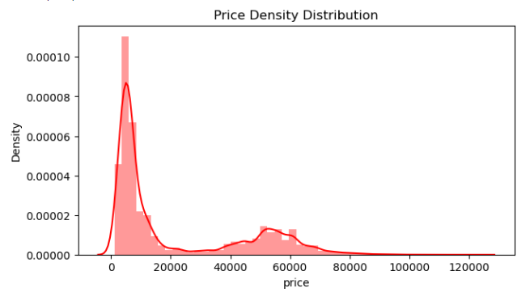
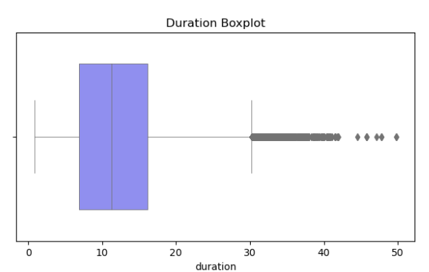
Exploratory Data Analysis (Univariate Analysis)
The entire EDA process was conducted in two phases, Univariate and Bi-variate Analysis.
Numerical
 | We can see that Duration and Price have Outliers, hence we might need to do outlier detection. Duration and price is Skewed left, hence defining need for normalization.

Slide 5
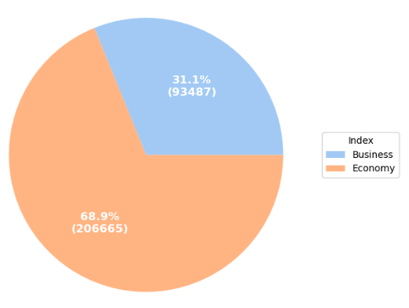
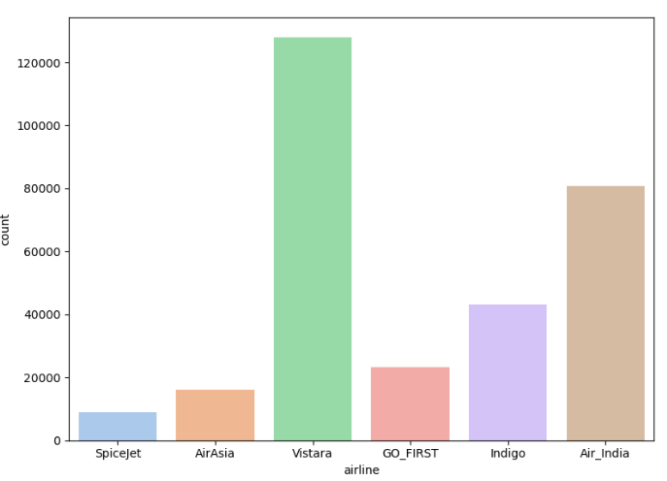
Exploratory Data Analysis (Univariate Analysis)
Categorical
 | We can see that the top players in the field are Vistara, followed by AirIndia. Most of them prefer their arrival time at night or evening, this is making sense - since most of them would hate reaching out of business hours for local flights. Economy class is more preferred by many people, but it's fair to say that there is good amount of passengers choosing the business class as well. Most of them prefer One - Stop Flights. (Probably it is cheaper) It can be seen that people hate catching late night flights, hence companies might need to drop flight charges in order to increase business here. Other timings seem to be always busy. There seems to be greater business for flights between Delhi and Mumbai.

Slide 6
Exploratory Data Analysis (Bivariate Analysis- Hypotheses results)
Observations:
Categorical Features: (ANOVA Results- Greater T-statistic,Greater the willingness to pay)
It can be assessed the passengers do care about the airline service that they choose, the arrival time of flight, the class and the number of stops the flight has.
Numeric Features:
We can say the the price of flight fares are increased by companies when it is close to the departure date, but this price reduction is very slight.
Duration of flight has no strong correlation with price.
All features are statistically significant

Slide 7
Research Questions:
Q1. Does price vary with Airlines?
Observation :
Price does vary based on airline, but a large amount of this effect because of lack of business class flights in other airlines apart from Air India and Vistara.
Q2. How is the price affected when tickets are bought in just 1 or 2 days before departure?
Observation :
Price is affected when bought 1-2 days before departure.
Q3. Does ticket price change based on the departure time and arrival time?
Observation :
Price varies with Departure and Arrival time.
Q4. How the price changes with change in Source and Destination?
Observation :
Price does not vary with both Source and Destination.
Q5. How does the ticket price vary between Economy and Business class?
Observation :
Only Air India and Vistara can be considered for our analysis, other airline dont have data for the business class.
For both Air India and Vistara there is a significant price difference.
For Air India the difference is around 40,000 and Vistara around 47,500.

Slide 8
Solution Analysis
Feature Engineering
The unique groups for pairs of arrival and departures were created.
Model Evaluation
Data Sub setting
The dataset was categorized into numeric and categorical and variables.
The model used was RandomForest Regressor.
Mean Squared Error: 7773142.662965195
Predicted Price: 6613.8
R-squared Score: 0.9849206402207609
Data Pre-processing
One hot encoding was performed for categorical variables and standard scalar on numeric
Standard Scalar on Numeric features was done.
Deployment
The pipeline was dumped as a pickle file.
Then an API was created for the pipeline.
A Front end is created which would be a user interface to give the details to predict the price.
Future work would be to dockerize the code and deploy the API on a cloud environment like GCP, Heroku.

